Slide 1

IMDb Movie Analysis
By
Stan Pereira

Slide 2
Content
01 Project Description
02 Approach
03 Tech-Stack Used
04 Insights
05 Results

Slide 3
Project Description
IMDb (Internet Movie Database) is an online database of information related to films, television series, podcasts, home videos, video games, and streaming content online – including cast, production crew and personal biographies, plot summaries, trivia, ratings, and fan and critical reviews.
The dataset provided is related to IMDB Movies. A potential problem to investigate could be: "What factors influence the success of a movie on IMDB?" Here, success can be defined by high IMDB ratings. The impact of this problem is significant for movie producers, directors, and investors who want to understand what makes a movie successful to make informed decisions in their future projects.

Slide 4
Approach
Data Cleaning
Data Analysis
Five 'Whys' Approach
Report and Data Story
Goal
This step involves preprocessing the data to make it suitable for analysis. It includes handling missing values, removing duplicates, converting data types if necessary, and possibly feature engineering.
Here, I will explore the data to understand the relationships between different variables. I will look at the correlation between movie ratings and other factors like genre, director, budget, etc.
This technique will help me dig deeper into the problem. For instance, if I find that movies with higher budgets tend to have higher ratings, I can ask "Why?" repeatedly to uncover the root cause.
After my analysis, I will create a report that tells a story with the data. This should include the initial problem, the findings, and the insights gained. I will use visualizations to help tell the story and make the findings more understandable.
The goal is not just to answer questions but to provide insights that can drive decision-making. The analysis should aim to provide actionable insights that can help stakeholders make informed decisions.

Slide 5
Data Cleaning
As part of the data cleaning, I made the below changes:
Determined the main columns required : IMDb Score, Movie Title, Genre, Movie Duration, Language, Director Name, Budget & Gross Earnings
Created a new column "Profit Margin" = ("Gross Earnings"-"Budget")
Removed rows that had blanks in the required columns
Removed duplicates in the required parameters – The Movie Title "The Host" was duplicate, but it was two different movies having the same name.
Total Number of Records before "Data Cleaning" was 5043
Total Number of Records after "Data Cleaning" became 3786

Slide 6
Tech Stack Used
The Software and Version Utilized
Microsoft 365 Online Excel Free Version 16.0.17012.41002
Ability to perform calculations, data analysis, data visualization, data transformation, and data cleaning with Excel tools and functions.
Automatic upgrades to the latest features and security updates.
More efficient remote work with cloud-based storage and collaboration tools.
Availability of free templates and code to customize and automate Excel.

Slide 7
Charts & Insights

Slide 8
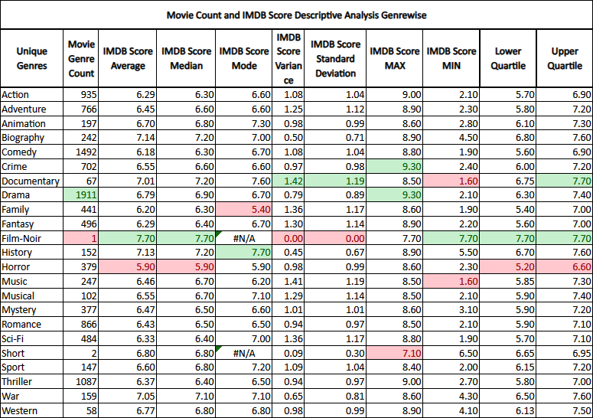
Q. A) Movie Genre Analysis: Analyze the distribution of movie genres and their impact on the IMDB score.
Task: Determine the most common genres of movies in the dataset. Then, for each genre, calculate descriptive statistics (mean, median, mode, range, variance, standard deviation) of the IMDB scores.

Slide 10
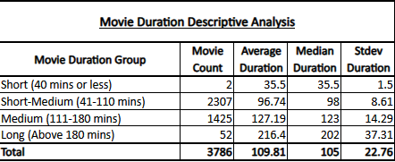
Q. B) Movie Duration Analysis: Analyze the distribution of movie durations and its impact on the IMDB score.
Task: Analyze the distribution of movie durations and identify the relationship between movie duration and IMDB score.

Slide 11
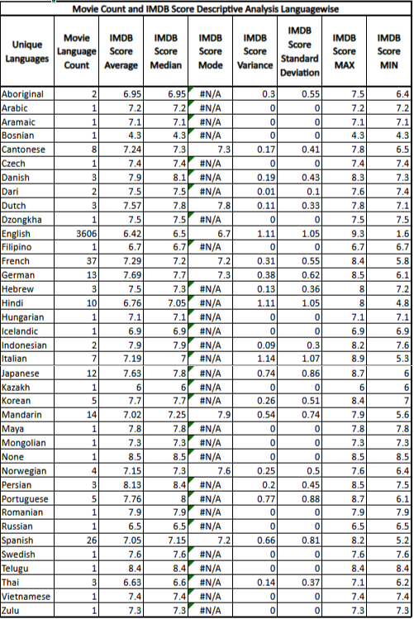
Q.C) Language Analysis: Examine the distribution of movies based on their language.
Task: Determine the most common languages used in movies and analyze their impact on the IMDB score using descriptive statistics.

Slide 13
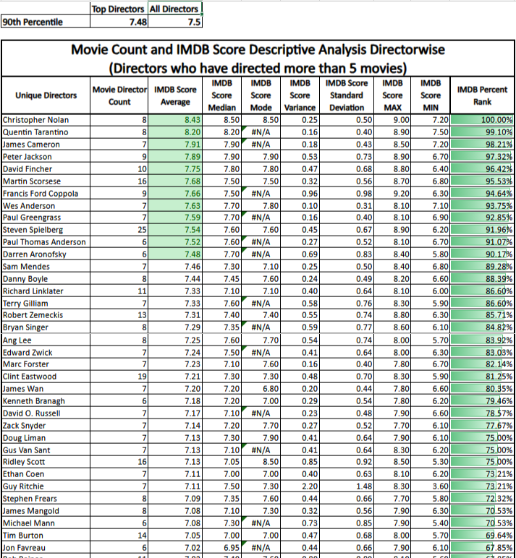
Q.D) Director Analysis: Influence of directors on movie ratings.
Task: Identify the top directors based on their average IMDB score and analyze their contribution to the success of movies using percentile calculations.

Slide 14
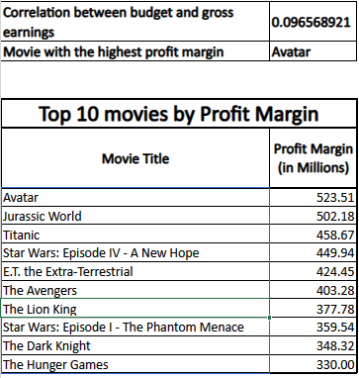
Q.E) Budget Analysis: Explore the relationship between movie budgets and their financial success.
Task: Analyze the correlation between movie budgets and gross earnings, and identify the movies with the highest profit margin.

Slide 16
Insights
Drama is the most common genre, followed by Comedy and Thriller.
Biography has the best IMDB Average (Film-Noir is not taken into account as it has only 1 movie), followed by History and War.
The mean, median and mode of all genres are mostly similar.
Most movies made are in the 41-110 mins duration category.
The average duration for a movie is 110 mins.
The relationship between movie duration and imdb scores has a slight upward trend.
The most popular language is English.
There are 1751 unique directors, but only 113 have directed over 5 movies and are used to rate the best.
Steven Spielberg has directed the most number of movies at 25.
Christopher Nolan is the most highly rated director at 8.43.
12 directors are in the 90th percentile based on IMDB Score Average which above 7.48.
Correlation between budget and gross earnings is 0.096 which means that there is little or no relation between Budget and Gross Earnings.
The movie with the highest profit margin is ‘Avatar’.

Slide 17
Results
The 'IMDb Movie Analysis' is important for movie producers, directors, and investors who want to understand what makes a movie successful. This allows them to make informed decisions in their future projects.
The project has helped me understand the relationship between various fields, like 'Genre & IMDb Score' and 'Budget & Earnings'. It has also helped me improve my knowledge of Data Analysis using Excel and Statistics.
This project allowed me to ask the question 'Why?', making me dive deeper to finally find the root cause.
Link to IMDB Movie Analysis Excel File

Slide 18

THANK YOU

